Slide 1


Computerized Cognitive Retraining Program for Home-Based Learning in Children with Special Abilities
Team- Manashi Banerjee , Hariom Chaudhary , Hemant Chaudhary
Mentor: Abhishek Kumar

Slide 2



Problem Statement:
Children with disabilities face challenges accessing cognitive retraining programs due to limited home-based options, highlighting the need for a computerized solution tailored to their needs to enhance learning outcomes and promote inclusion.

Slide 3

Current Problem-
Pandemic led to cognitive decline in students (Reffiane et al., 2021).
Fear and unclear guidance exacerbated the situation (Salas-Rueda et al., 2021; Fitriani et al., 2022).
Reduced knowledge and problem-solving skills observed (Munir et al., 2021; Sholahuddin et al., 2020).
Teachers face challenges with varying numbers of special needs students.
Urgent need for tailored support and innovative strategies to address academic impacts.

Slide 4

Solution-
Implement interactive and varied learning activities to maintain student engagement.
Incorporate multimedia resources, interactive discussions, and project-based assignments.
Prioritise diverse and engaging learning experiences to ensure integrated learning remains stimulating and meaningful for
students in online environments

Slide 5
Objectives-
01.
Develop an accessible platform for distance learning, assignments, tutoring, and engaging content tailored for children with short attention spans and verbal disabilities.
02.
Implement a robust feedback system to provide timely evaluation and progress analysis for students.
03.
Use machine learning for personalized content and assignments. Adapt continuously to support diverse student needs, including shorter attention spans and verbal disabilities.

Slide 6

Project Timeline-
Frontend
Backend
React: Framework for making frontend
Nodjs : for backend.
MongoDB: for storing data
ML (Training of Models)
Testing and Further Taining
Planning
and Designing Architecture
NLP
Computer Vision

Slide 7
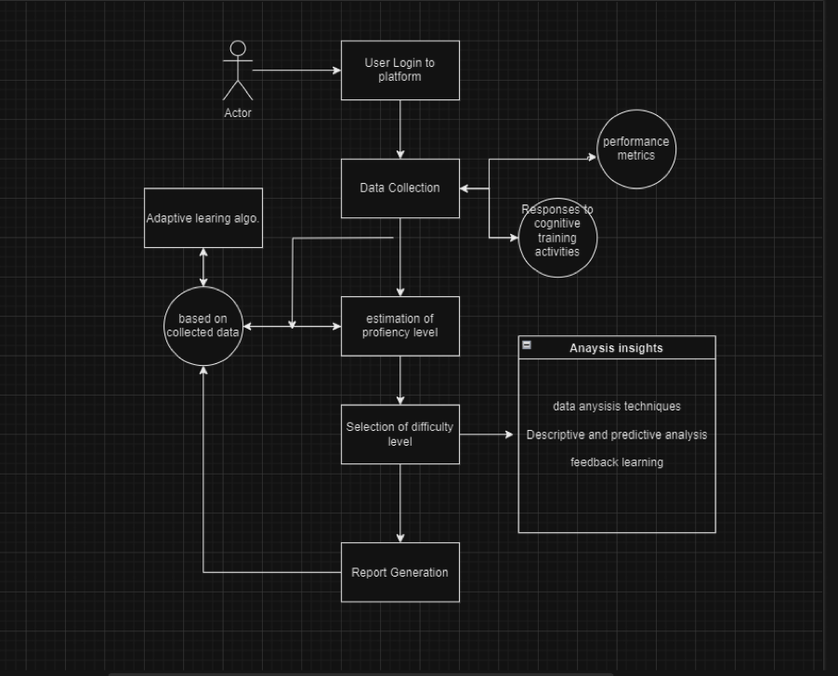
Data Flow:

Slide 8
LITERATURE REVIEW
Sr.No. | Journals | Year | Techniques | Conclusion
1. | An Integrative Approach to Improve Students' Cognitive Ability Through Online Learning in The Covid-19 Pandemic | 2022 | Integrated Learning | Identified decline in students' cognitive abilities during Covid-19 online learning. Significant increase in students' cognitive x observed through integrated learning. Pre-test average score: 32.17; Post-test average score: 48.47.

Slide 9
LITERATURE REVIEW
Sr.No. | Journals | Year | Techniques | Conclusion
2. | Computer-Based Cognitive Rehabilitation Interventions for Traumatic Brain Injury: A Critical Review of the Literature | 2017 | electronic databases PubMed/MEDLINE, PsycInfo, and CINAHL | computer-based interventions seem promising as an approach to improve working memory in individuals with acquired brain injury the identified studies did not use a standard method for assessing the severity of traumatic brain injury. Age of injury , materialized points and number of injuries effects the person differetly .

Slide 10
LITERATURE REVIEW
Sr.No. | Journals | Year | Techniques | Conclusion
3. | Home-Based Computer-Assisted Cognitive Training | 2015 | Data Analysis, randomized controlled trial | Home based education have more better results over clinic based education. Number of hours / time given to the training effects the progress of a student.

Slide 11
LITERATURE REVIEW
Sr.No. | Journals | Year | Techniques | Conclusion
4. | Computer-Based Cognitive Training for Executive Functions after Stroke: A Systematic Review | 2015 | Search - MEDLINE, PsycINFO, Web of Science. CONSORT for analysis. | Most studies we reviewed suffered from methodological limitations. Samples were mostly small, appropriate control groups were often absent, and adjustment for multiple testing was rarely done. Effects were most often reported on non-trained tasks that measured the function being trained.

Slide 12
LITERATURE REVIEW
Sr.No. | Journals | Year | Techniques | Conclusion
5. | A systematic review of pediatric cognitive rehabilitation in the elementary and middle school systems | 2015 | integrated learning , problem solving , reasoning. | This systematic review identifies several avenues for effective therapeutic interventions for school aged TBI survivors. Many are supported by laboratory based efficacy studies. Future research should investigate optimal ages for particular treatments, as well as, the effectiveness of treatments across different social settings.

Slide 13
LITERATURE REVIEW
Sr.No. | Journals | Year | Techniques | Conclusion
6. | Does Access Matter? Time in General Education and Achievement for Students With Disabilities | 2013 | Data Analysis | This study examined the relationship between hours in general education and achievement in reading and mathematics for students with disabilities.

Slide 14
LITERATURE REVIEW
Sr.No. | Journals | Year | Techniques | Conclusion
7. | Academic Progress of Students Across Inclusive and Traditional Settings | 2013 | It was an article paper. | Students without disabilities in inclusive settings made significant academic progress in math and reading. Students with disabilities, including those with specific labels like learning disabilities and mild mental handicaps, also showed academic progress in inclusive education. Overall, inclusive education benefits both students without disabilities and those with disabilities in terms of academic progress and achievement.

Slide 15

Thank you very much!
Team- Manashi Banerjee , Hariom Chaudhary , Hemant Chaudhary
Mentor: Abhishek Kumar

